Slide 1

Data Replication and Synchronization Tool
Ashish Sharma
Pradeeban Kathiravelu
Powerpoint Templates

Slide 2
Introduction

Slide 3
Motivation

Slide 4
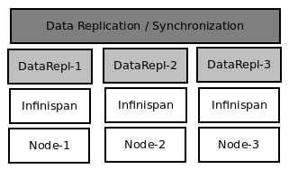
Solution Architecture
Users create, share, and update replica sets from a data source.
Infinispan In-Memory Data Grid (version 6.0.2) to store the replica sets.
Fig 1. Deployment Architecture

Slide 5
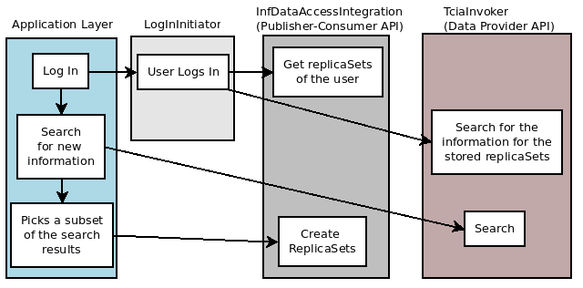
Execution Flow
Publisher-Consumer API to consume the replica sets and Data Provider API to communicate with the data source.
Fig 2. Execution Flow

Slide 6
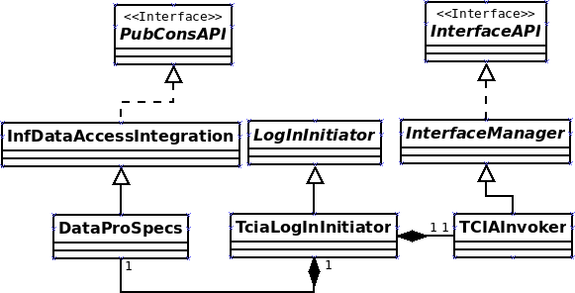
Design
DataProSpecs API
  createReplicaSet
  getReplicaSet
  updateReplicaSet
Fig 3. Back-end Class Hierarchy
duplicateReplicaSet
deleteReplicaSet

Slide 7
Extensibility
Not tightly coupled to the technology.
  Other data-grids
    Hazelcast, Terracotta Big Memory, Oracle Coherence
  Persistence
    Integration to SQL or NoSQL solutions such as Mongo DB.
  Data sources other than TCIA.

Slide 8
What Infinispan offers?
High Performance and Scalability.
Fault-tolerance
  Multiple nodes with TCP-IP or Multicast based JGroups clustering configurations.
Distributed Execution.
  Optimized for single node as a local cache as well as a multiple-node execution.
MapReduce Framework.

Slide 9
What Infinispan offers?
High Performance and Scalable.
Fault-tolerant
  Multiple nodes with TCP-IP or Multicast based JGroups clustering configurations.
Distributed Execution.
  Optimized for single node as a local cache as well as a multiple-node execution.
MapReduce Framework.
Thank you!

Slide 10

What Infinispan offers?
High Performance and Scalable.
Fault-tolerant
  Multiple nodes with TCP-IP or Multicast based JGroups clustering configurations.
Distributed Execution.
  Optimized for single node as a local cache as well as a multiple-node execution.
MapReduce Framework.
Thank you!

